Slide 1
QUALITY ANALYSIS DATASET
GROUP 10: CHANDRA SHEKHAR SHUKLA KAVYA SHARAWAT PRERAK MITTAL

Slide 2
1.
2.
3.
4.
Data Visualization
Presenting data in a visually appealing and understandable format for the strategic level.
Enable users to interact with data, enhancing the ability to drill down into details, filter information, and gain a deeper understanding of the data.
Performance Tracking
By monitoring performance over time, effectiveness of strategies and identifying areas for improvement is accessed.
Utilize predictive modeling to forecast future trends and outcomes.
Data Integration
Consolidate data from various sources to increase understanding of the business.
Real-time Monitoring
Monitors real time KPIs to respond promptly to changes, identify issues, and capitalize opportunities.

Slide 3
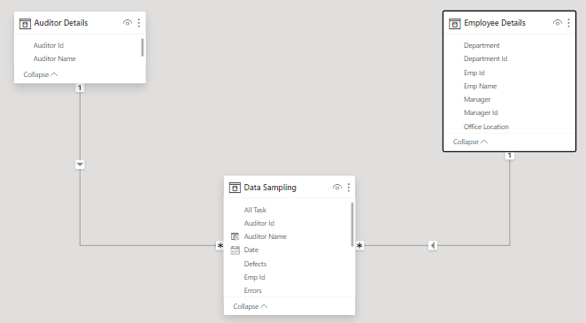
Data Model: Star Schema
Star Schema
Power BI, the star schema data model is a structure used for organizing and connecting tables in a way that facilitates efficient data analysis and reporting.
Fact Table: Central table containing numerical measures Dimension Tables:Store descriptive attributes related to the measures in the fact table.
Relationships:Establish relationships between the fact table and dimension tables.Typically, one-to-many relationships from dimensions to the fact table.
Benefits:Simplifies queries and improves performance. Using the star schema in Power BI makes it easier to analyze and visualize data in a structured and meaningful way.
.

Slide 4
MOST USED DATA
Auditors ID
All Tasks
Defects
Employee ID
Samples
Date
Manager ID
Errors
Department
Notes:
The multiple initiatives announced clearly reflect the government’s intent to address the malaise. However, on-the-ground experience shows that the implementation of these initiatives needs greater attention for them to be more effective.
So, the faceless assessment scheme was introduced to facilitate the expeditious disposal of cases in a transparent and efficient manner, and as per functional specialisation.
We will discuss DRS and BAR in detail in the next slides.

Slide 5
OBJECTIVE: QUALITY ANALYSIS DATASET
Analyse the quality work of Auditors
Comparing and predicting future samples, defects and errors
Management of employees work and diversity within organization
Analyzing the role of special events and dates on work quality
Optimizing Delegation of work
Notes:
It is the FIRST APPELLATE AUTHORITY in the four-tier appellate hierarchy.
The first appeal AGAINST the order of the ASSESSMENT ORDER lies with the CIT(A).
The CIT(A) is NOT AN INDEPENDENT BODY and is under the administrative control of the ministry of finance.
The CIT if satisfied that the Assessment Officer’s order is ERRONEOUS AND PREJUDICIAL, then they might pass a suitable order enhancing or modifying or reducing or confirming or annulling the order passed by the AO.
It is INCUMBENT for the CIT to provide a fair opportunity of hearing to the taxpayer.

Slide 6
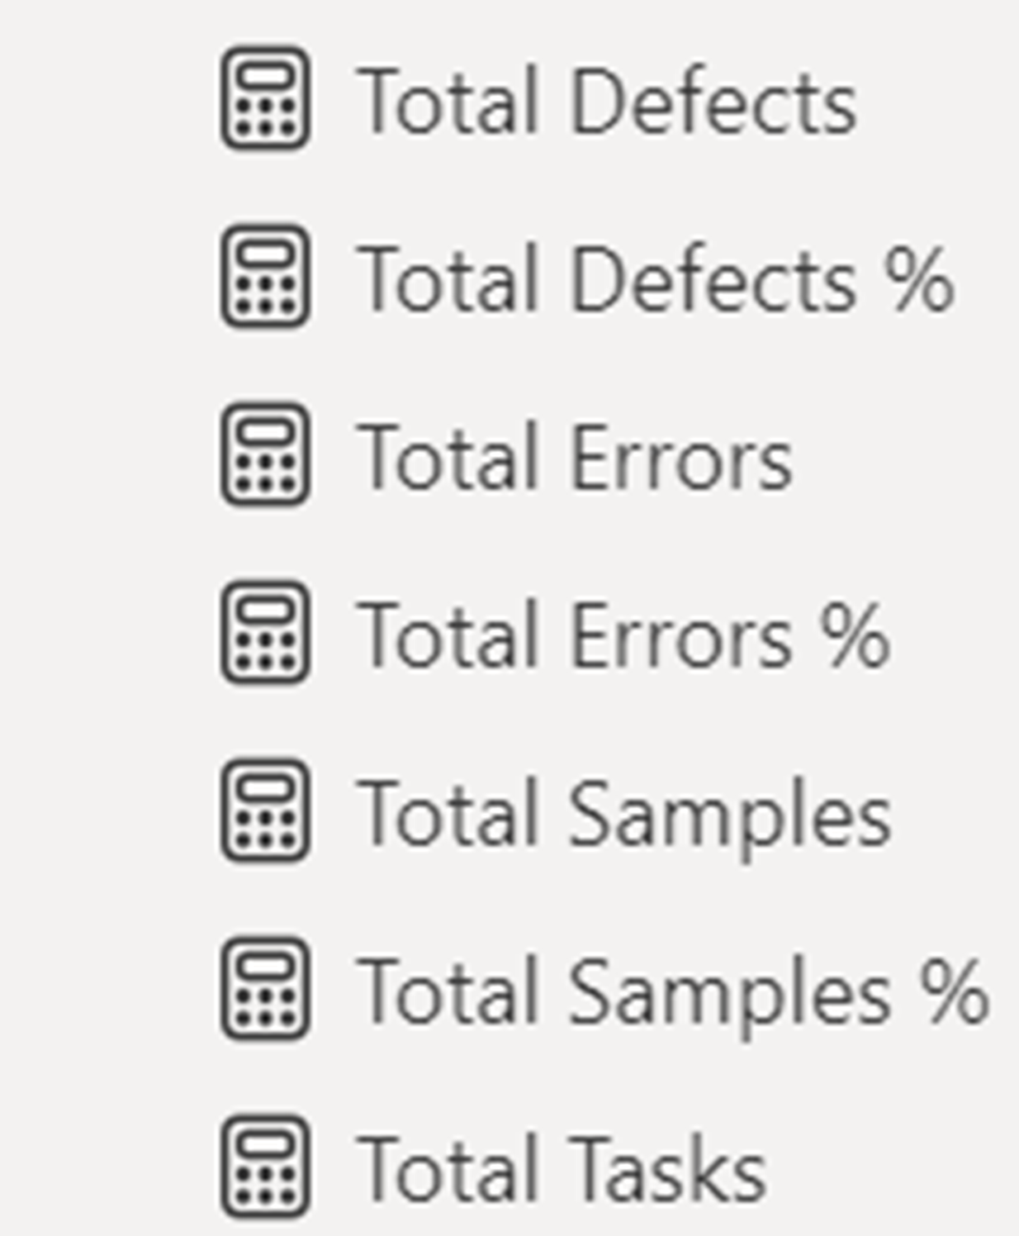
DAX MEASURES
.
.
Total
Total Defects = SUM('Data Sampling'[Defects])
Total
Total Defects % = ('Data Sampling'[Total Defects]/'Data Sampling'[Total Tasks])* 100
Total
Total Errors = SUM('Data Sampling'[Errors])
Total
Total Errors% = ('Data Sampling'[Total Errors]/'Data Sampling'[Total Tasks])* 100
Total
Total Samples = SUM('Data Sampling'[Samples])
Total
Total Samples % = ('Data Sampling'[Total Samples]/'Data Sampling'[Total Tasks])* 100
Total
Total Tasks = SUM('Data Sampling'[Tasks])

Slide 7
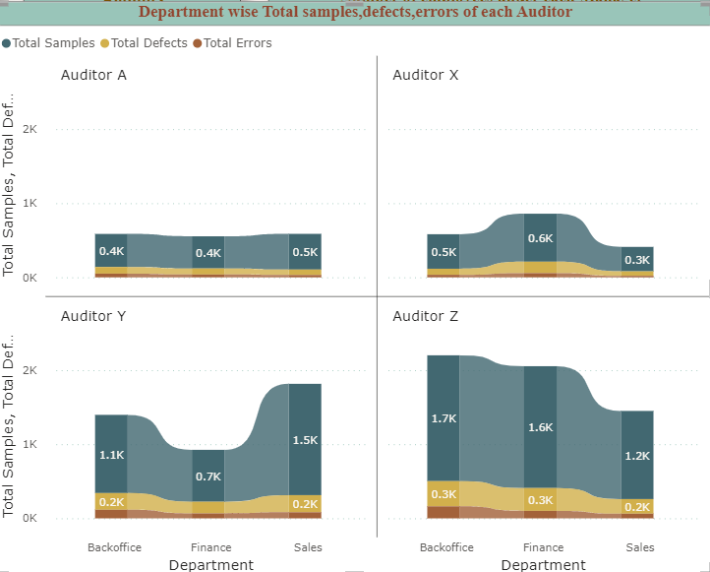
Ribbon Chart
Data Labelled Ribbon Chart
Shows Department wise Total Samples, Errors and Defects
The grid multiples provide performance per Auditor
Maximum number of Sampling in Department : Sales
Auditor with maximum number of sampling: Auditor Z
.
Department wise Total samples, defects, errors of each Auditor

Slide 8
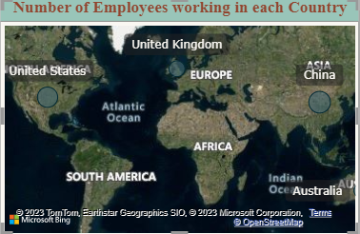
MAP
Shows employee count working from the following countries:
United states
United Kingdom
China
Australia
Bubble size indicates the number of employees from each country.
Max: 22 Employees are from CHINA
Min: 8 Employees are from AUSTRALIA

Slide 9
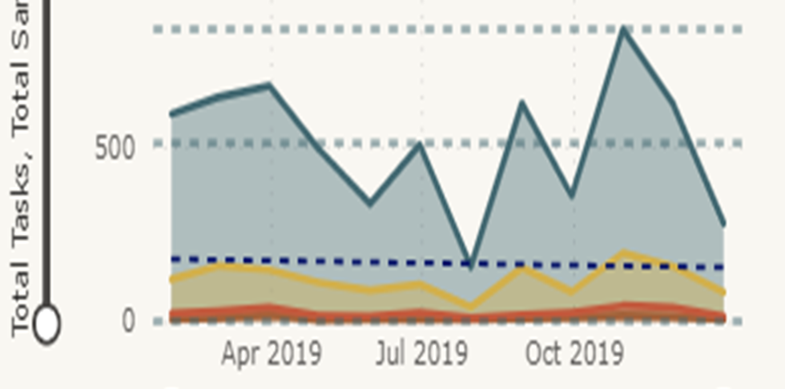
Area Chart
Date wise Predictive Area chart
Shows Department wise Total Samples, Errors and Defects
Shows Maximum line and Average line
Used to analyze and predict the future tasks, samples, errors and defects
.
Drilled down Day wise Total samples, defects, errors of each Auditor

Slide 10
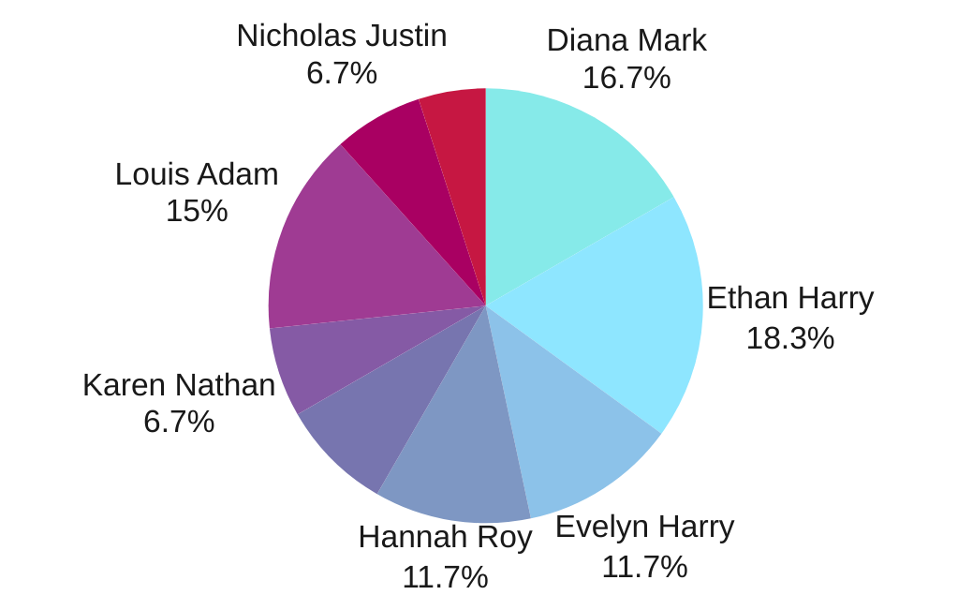
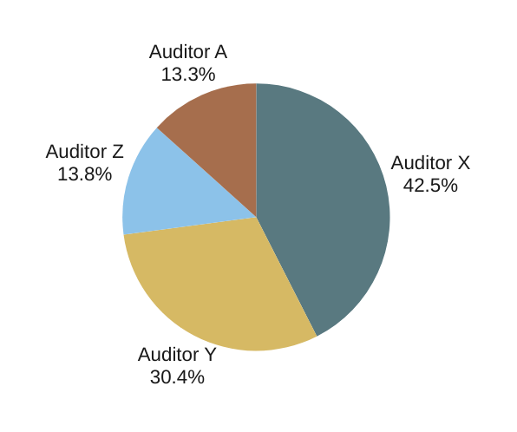
.
Pie Chart
Pie chart featuring number of employees under each Manager and number of tasks done by each Auditor respectively.
Ethan Harry manages the most number of employees
Auditor X is delegated to 42.5% of the employees

Slide 11
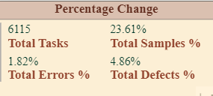
Multi Row - Card
Includes DAX Measures
Interacts with selection of Slicers and Charts to showcase Percentage change and Total Task.
Used to understand the percentage change in Sampling, Defects and errors.
.
Percentage Change Scorecard using DAX

Slide 12
Slicer
Auditors
Auditor Name
- Auditor A
- Auditor X
- Auditor Y
- Auditor Z
Date
- 31-01-2019
- 31-12-2019
Timeline
Department
- Back Office
- Finance
- Sales

Slide 13
